Slide 1
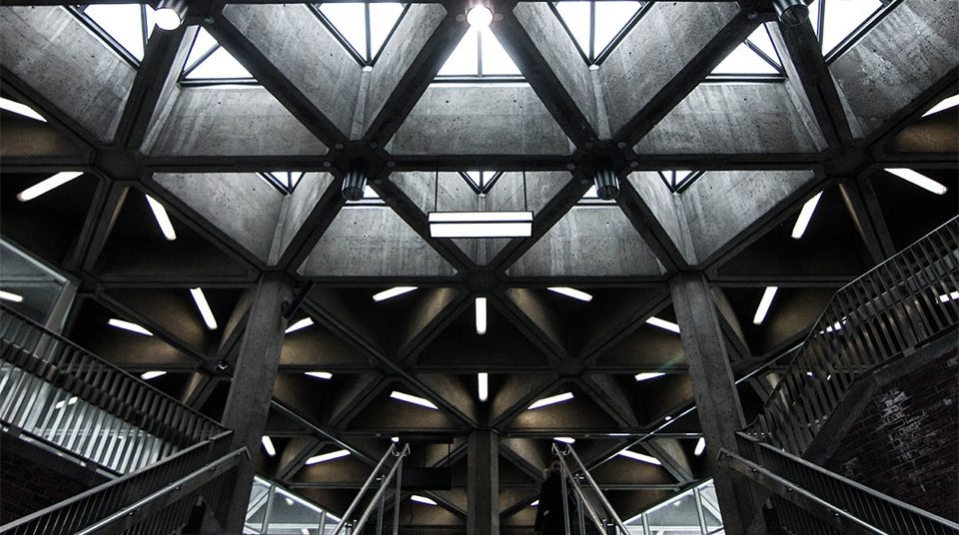
Who Is Wachira Wahome?
Autobiography Presentation by
Joseph Wachira

Slide 2


Introduction
Autobiography
Of
Joseph Wachira

Slide 3

Early life
Hello there! My name is Joseph Wachira and I am 21 years old. At present, I am studying at Dedan Kimathi University of Technology (DeKUT) in my final year, pursuing a Bachelor’s degree in Information Technology. I hope you will find my autobiography interesting and insightful, offering a glimpse into life in my country.

Slide 4

Background and Early Memories
Subsection: Family Background
Born on March 3, 2003, at Nyeri Provincial General Hospital.
Grew up in Nyeri County, Kieni East District, Kabaru Ward.
Parents: Mr. and Mrs. Wahome, who emphasize the importance of education.
Siblings: John, Stephen, and Peter.
Subsection: Early Memories
Baptized at Jet Catholic Church at age three.
Close bond with siblings, sharing weekend activities and family traditions.
Grandparents' stories instill a deep respect for family history.

Slide 5

Title
Childhood Memories
School Life
Passionate about Mathematics, Science, Art, and Physical Education.
Fond memories of primary school: favorite subjects, teachers, and playground games.
Struggles with language subjects but a love for reading stories.
Enjoyed lunchtime and playtime with friends, despite occasional embarrassing moments.
Vivid Christmas memory receiving my first PlayStation, filled with excitement and joy.
Memorable day trip to Millport, bike riding with friends, and narrowly avoiding an accident.

Slide 6
Family and interests
Great gran, Nessie Arthur’s life story: from Scotland to Canada and back, filled with resilience.
Parents' encouragement and the impact of their support on my education and personal growth.
Passion for soccer, being a part of the school team, and learning teamwork and sportsmanship.
Love for drawing, painting, and expressing creativity through art.
Enjoy cooking with parents, exploring new recipes, and bonding over culinary experiments.
Enthusiasm for nature, hiking, and exploring the outdoors with family.
Family Influence and Personal Interests

Slide 7
Challenges and growth
Overcoming Obstacles
Content:
Childhood bumps: dealing with illness, embarrassing school moments, and learning resilience.
Dislikes: tight Adiadora jumper, tomatoes, cucumbers, and children's songs disrupting sleep.
Subsection: Life Lessons
Importance of perseverance and adapting to challenges.
Support from family and friends in overcoming difficulties.
Embracing personal dislikes as part of the growing experience.

Slide 8
High School
Baricho Boys High School, the only national public secondary school in Kirinyaga, was founded in 1960. It has grown into one of the leading public secondary schools both locally and nationally. Led by the benevolent principal, Mr. Bernard Kinga, the school emphasizes academic, physical, social, moral, and spiritual growth. Located on the windward side of Mt. Kenya, it offers a serene environment for learning. The school's motto, "High We Aim," motivates students, teachers, and staff alike.

Slide 9
High School Life
My love for sports, especially soccer and handball, flourished in secondary school. My fondest memory was during my third term in form one, when I first stood on the court, nervous yet excited. Though I didn't shine that day, it ignited my passion for sports. Reflecting on those early days, I decided to take sports seriously, and what started as a fun pastime became a vital part of my identity.
Practicing shooting hoops and watching my favorite players during entertainment hours brought me happiness and taught me dedication and hard work. Over the years, I improved my skills and joined school teams, forming priceless camaraderie with teammates. Whether we won or lost, our shared experiences off the court enriched my high school journey.

Slide 10
High School Life
I adopted a serious approach to my studies while juggling basketball, handball, and various extracurricular activities. I wasn't the top student, but I was committed. Team sports taught me dedication and the importance of collaboration. Each game boosted my confidence and established friendships that made high school enjoyable.
My involvement in clubs like Red Cross, Young Farmers, Wildlife & Tourism, and journalism enriched my high school experience. As a member of the school scout troop, I learned valuable life skills like discipline and leadership. These experiences shaped my worldview, teaching me responsibility and teamwork.

Slide 11
Campus Life
After completing high school, I received a letter from KUCCPS indicating my earlier choice of school. However, things took a different turn, and I decided to reapply to different universities and courses. With extensive research, aid, and preparation, I applied to several schools, including DeKUT and JKUAT. The process was both daunting and thrilling.
Applying to tertiary schools was rigorous and tedious. I spent countless hours researching universities, reading about programs, campus culture, and alumni success stories. I crafted my personal statement, highlighting my achievements, activities, and aspirations. Documents like the KCSE leaving certificate and result slip were crucial. I sought feedback from teachers, mentors, peers, and family to strengthen my application.

Slide 12
School Admission
Dedan Kimathi University of Technology, named after a famous hero and freedom fighter, has an excellent reputation. Located in Nyeri County, it spans about 1,000 acres with natural forests, coffee plantations, and open space for expansion. The institution is well-equipped with facilities and equipment to enhance students' studies, providing holistic and quality education along with extracurricular activities.

Slide 13
School Life
Reporting to the university's main campus marked the transition from high school to college life. For accommodation, I chose dorms, which allowed me to form close connections with fellow students and access resources.
During the four years in university, I have achieved several personal milestones. I completed a significant final year project creating a web application to manage different operations in dental clinic, it was also to help automate the both customer and administrative services. I worked on the project for a period of six months that the school had allocated for everyone.

Slide 14
Life in School
As I now navigate my campus life at Dedan Kimathi University, I am keenly focused on my studies and actively engage in various student organizations.
My experience has reinforced my passion for technology and innovation, leading me to pursue a career in software development.
My ambition is to secure an internship to gain practical experience and further hone my skills.

Slide 15
The end
Thank You

